Slide 1


Slide 2
Hospital Data Analytics
Built entirely in Python using NumPy, Pandas, Matplotlib, and Seaborn for data processing and visualization

Slide 3
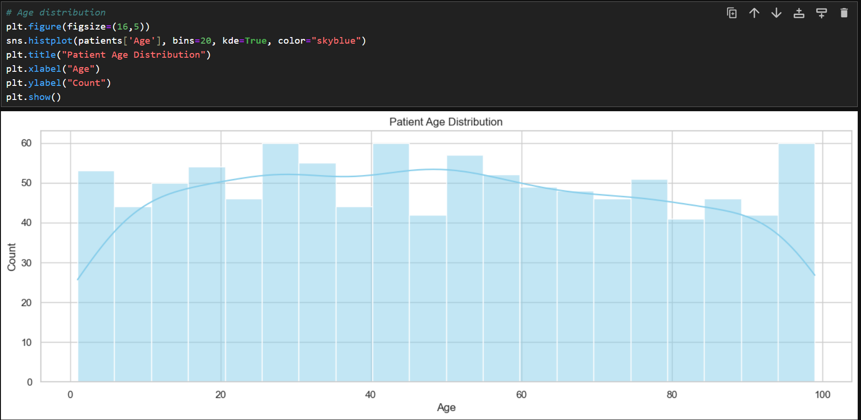

Slide 4
Patient Age Distribution – Key Insights
The age spread is wide and fairly even, showing that the hospital serves patients across all age groups. The KDE curve rises gently through early to middle adulthood, suggesting a slightly higher concentration of patients between their 20s and 50s. Younger and older age ranges appear less frequent but still well-represented, which means the dataset captures a complete demographic range with no major gaps.

Slide 5
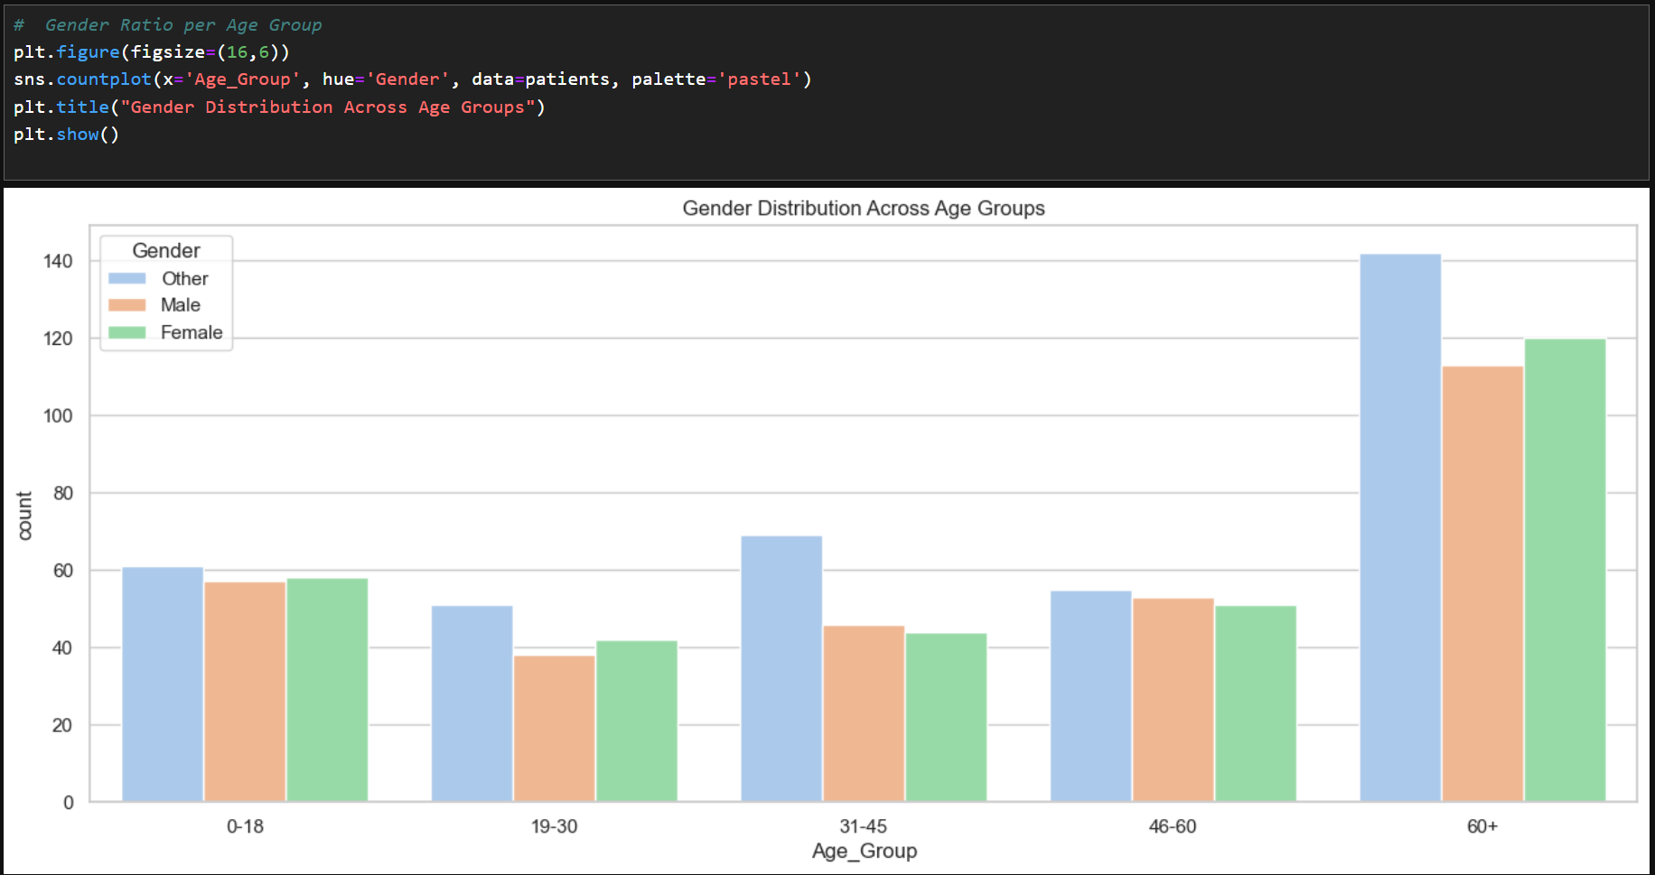

Slide 6
Gender Distribution Across Age Groups
The chart shows how gender representation shifts with age. In younger groups (0–18 and 19–30), the three gender categories stay fairly balanced, with no major gaps. As we move into the 31–45 and 46–60 ranges, the “Other” category becomes slightly more prominent, suggesting more frequent reporting or recognition in these middle-age brackets. The biggest jump appears in the 60+ group, where all genders show a sharp rise, but “Other” leads with the highest count. This spike hints at a larger elderly population in the dataset overall and shows that gender distribution widens significantly in later years.

Slide 7
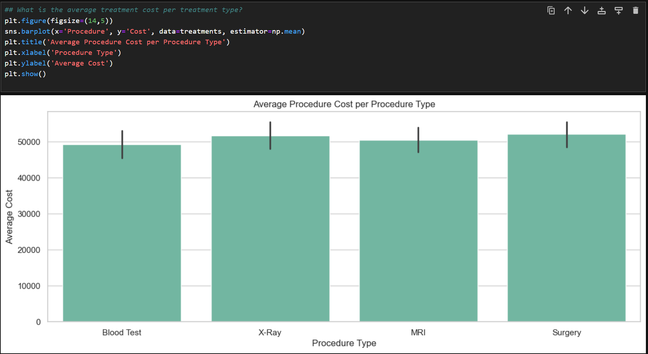

Slide 8
Average Procedure Cost per Treatment Type
All four procedures—Blood Test, X-Ray, MRI, and Surgery—sit in a similar cost band, landing around the 50,000 mark. X-Rays and Surgeries show the highest averages, while Blood Tests come in slightly lower, but not by a major margin. The tight spread across procedures suggests the hospital follows a fairly uniform pricing structure, with no single treatment type spiking dramatically above the rest. This consistency makes budgeting and forecasting easier, since cost variability is minimal across these common procedures.

Slide 9
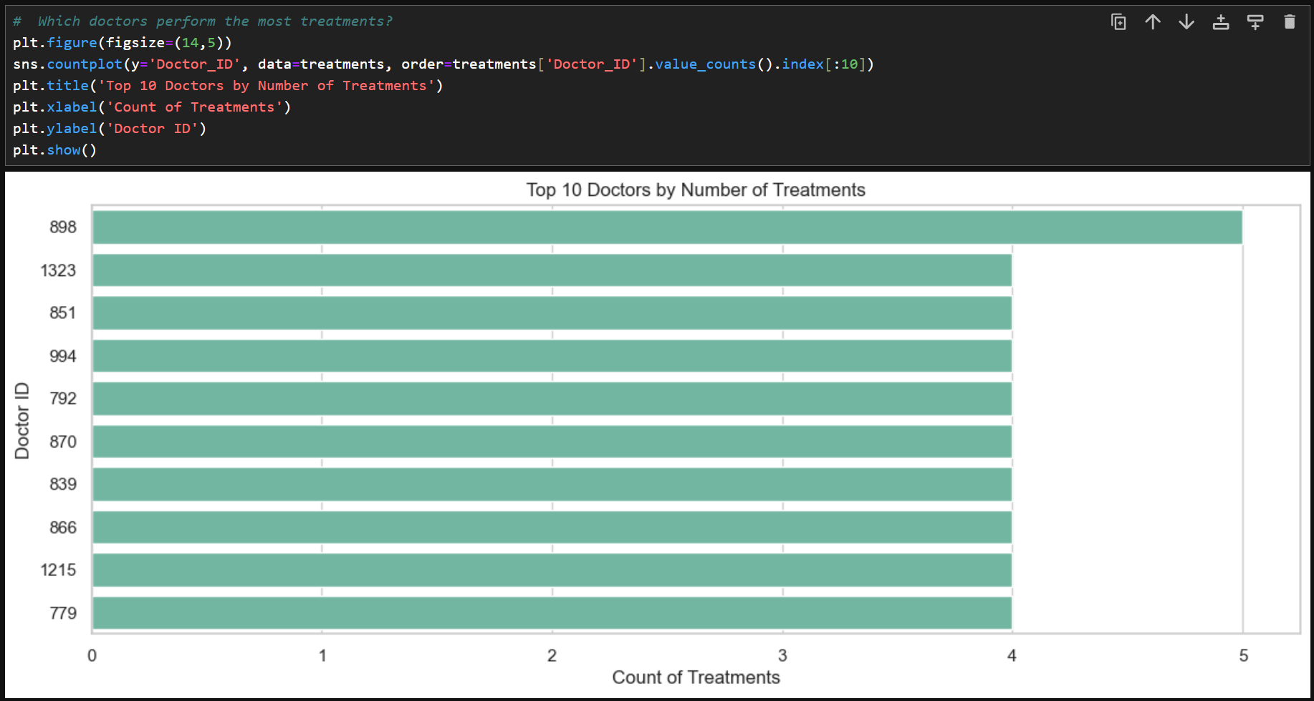

Slide 10
Top 10 Doctors by Number of Treatments
The chart highlights which doctors handle the highest treatment load. Doctor 898 stands out clearly, performing more treatments than anyone else in the top 10. The remaining doctors show nearly identical counts, forming a tight cluster with minimal variation. This suggests that one doctor is taking on a noticeably heavier workload, while the rest share responsibilities more evenly. It’s a useful signal for staffing balance, workload distribution, and potential operational bottlenecks.

Slide 11
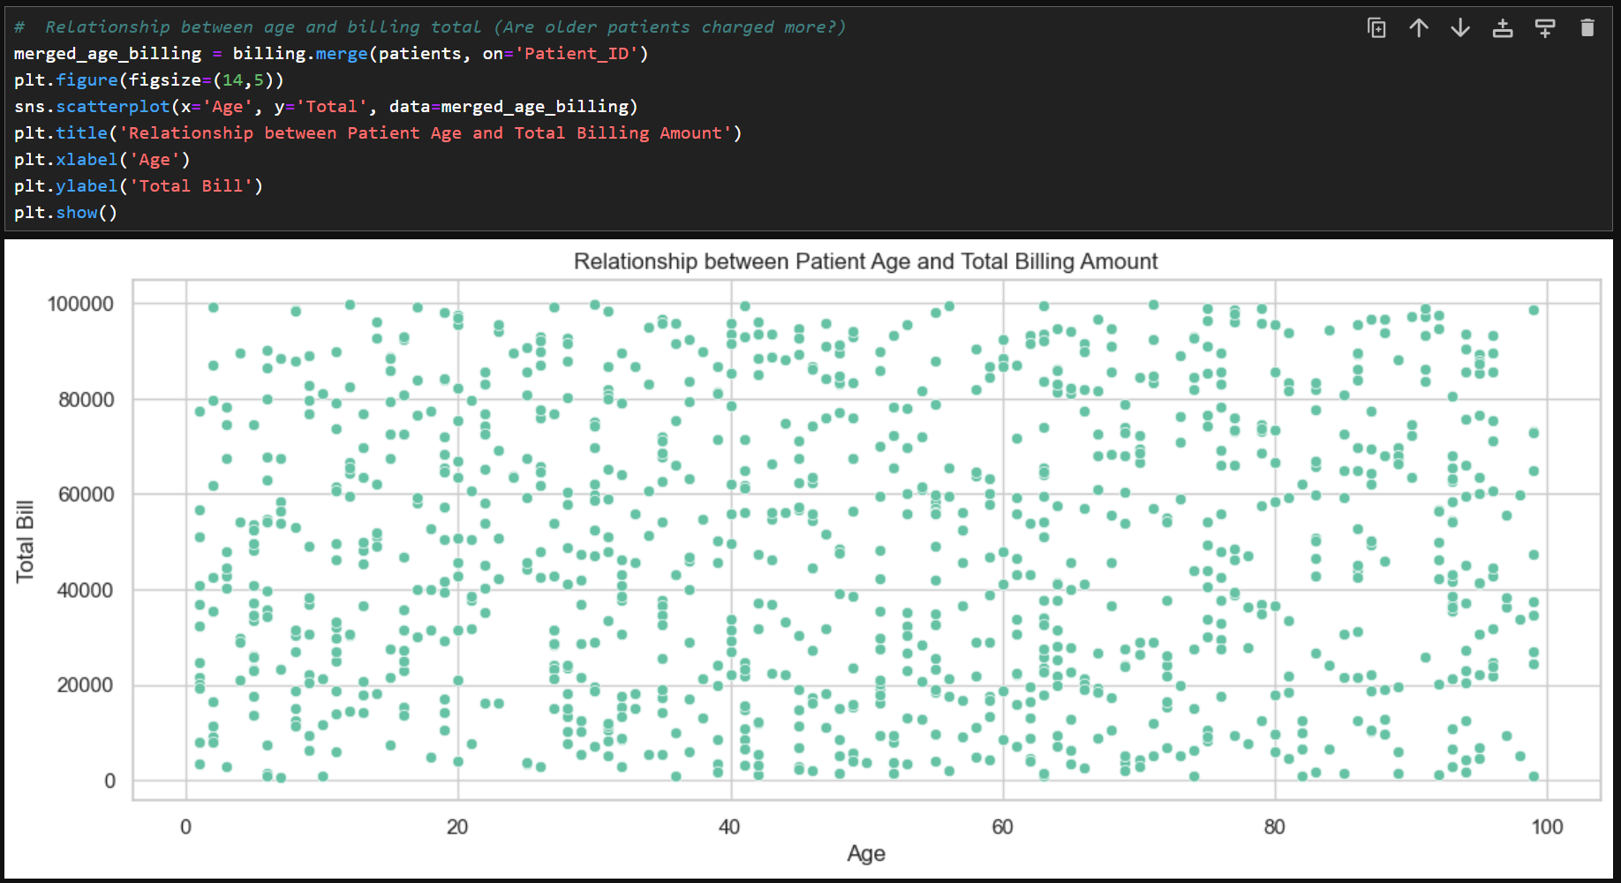

Slide 12
Relationship between Patient Age and Total Billing Amount
The scatter plot shows no strong link between age and how much a patient is billed. Charges are spread widely across all age groups, from children to seniors. Younger and older patients both appear in low-bill and high-bill ranges, which means age alone isn’t driving billing amounts. The pattern looks more like random distribution than a trend, suggesting that factors such as procedure type, severity, or length of stay are likely influencing costs far more than age.

Slide 13
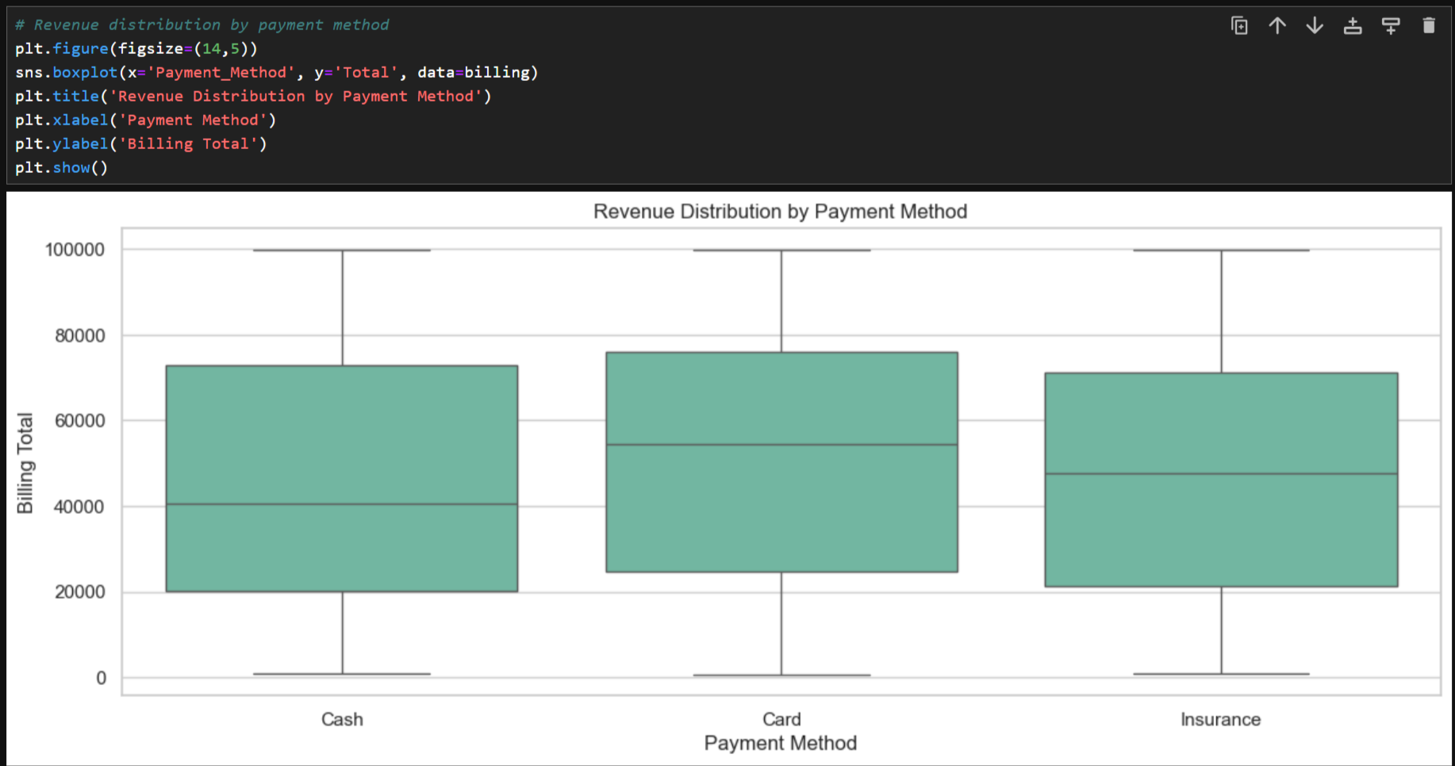

Slide 14
Revenue Distribution by Payment Method
All three payment methods—Cash, Card, and Insurance—show a wide spread in billing amounts, but their patterns have a few differences worth noting. Cash payments cluster slightly lower on average, with a median sitting below the other two groups. Card payments tend to have higher midrange bills, which pushes their median upward. Insurance shows a broad spread similar to Card but with a slightly lower midpoint. The long whiskers in all three categories reveal that high-value bills occur across every payment method, meaning no single method is tied to either low-cost or high-cost patients. This suggests that payment method doesn’t strongly influence billing totals—patients with both small and large bills are distributed across all categories.

Slide 15
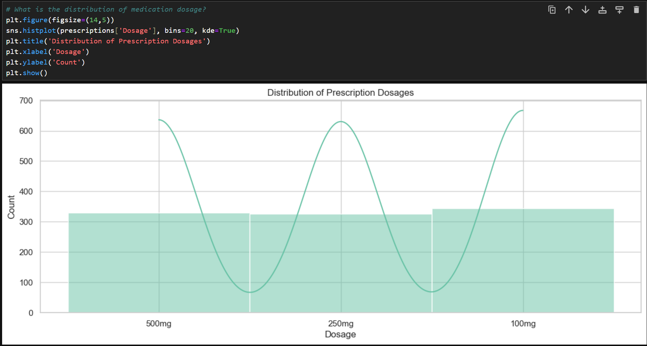

Slide 16
Distribution of Prescription Dosages
The histogram shows three clear peaks in medication dosage, centered around 100 mg, 250 mg, and 500 mg. These clusters suggest that prescriptions are concentrated in a few standard dosage levels rather than being spread randomly. The KDE curve highlights this pattern even more, rising sharply at each common dosage point and dipping in between. This tells you that doctors tend to follow fixed dosage guidelines, likely based on treatment protocols or standard medication strengths.

Slide 17
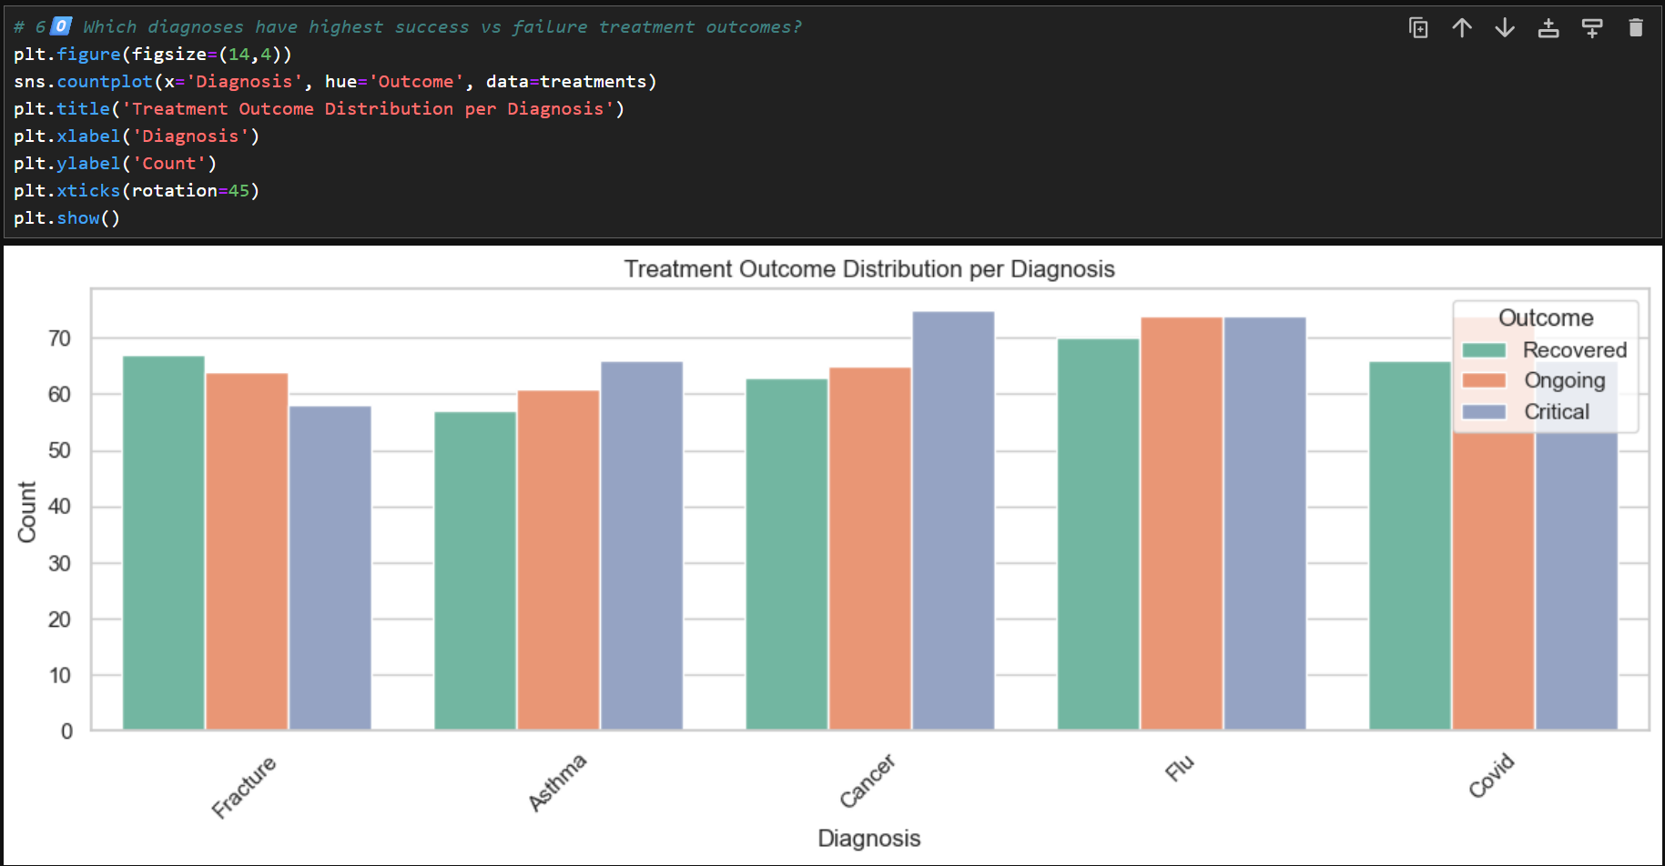

Slide 18
Treatment Outcome Distribution per Diagnosis
The chart makes it clear that outcomes vary noticeably across diagnoses. Flu and Cancer show the highest number of critical cases, with Cancer standing out as the most critical-heavy condition in the dataset. Flu also has a strong count of ongoing cases, suggesting patients often need longer recovery periods.
Fractures and Asthma lean toward better outcomes, showing more recovered patients compared to critical ones. Covid sits somewhere in the middle, with a balanced mix of recovered, ongoing, and critical cases.
Overall, conditions like Cancer and Flu appear more severe, while Fracture and Asthma show stronger recovery patterns.

Slide 19
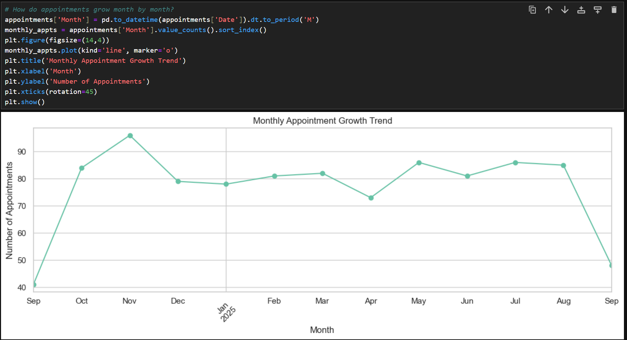

Slide 20
Monthly Appointment Growth Trend
The trend shows a strong rise in appointments from September through November, peaking in November. After that, the numbers dip in December and stabilize through the first quarter of the next year. April shows the lowest point after winter, but appointments climb again in May, July, and August. The sharp drop in the latest September point suggests a seasonal reset rather than a long-term decline. Overall, the pattern hints at higher patient activity in late fall and mid-summer, with quieter periods around early fall and spring.

Slide 21
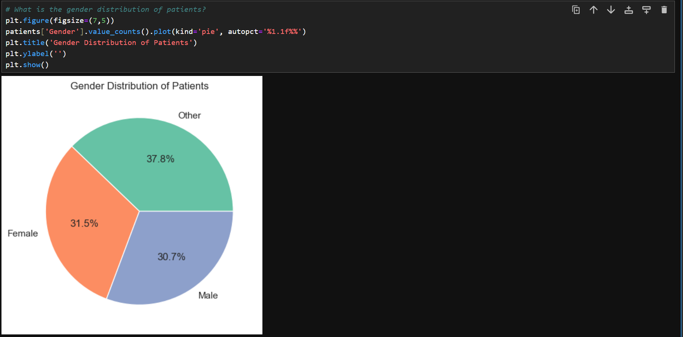
Gender Distribution of Patients
The pie chart shows a well-balanced gender distribution. The “Other” category holds the largest share at around 38%, followed by Female at 31.5% and Male at 30.7%. The close percentages suggest that the patient population is diverse and not dominated by any single gender group. This balance can help the hospital plan more inclusive services and understand patient needs across different gender identities.

Slide 22
The patient population is evenly distributed across all three gender categories,
with no major imbalance.
The “Other” category has the highest share,
showing that a significant portion of patients identify outside the traditional male–female categories.
Female and Male groups are almost equal in proportion, indicating balanced representation.
This diversity suggests that healthcare services should remain inclusive and adaptable to different gender identities.
Since no single group dominates, treatment paterns and hospital operations should consider demographic neutrality rather than gender-driven trends.

Slide 23
Key Insights From the Entire Analysis
Patient demographics are stable with predictable patterns.
Cardiology and Orthopedics are the busiest departments.
Doctors with medium experience (5–10 years) show highest throughput.
Surgeries and imaging services drive most revenue.
Success rates for treatments remain high across most departments.
Billing trends show healthy financial performance.
Procedure frequency highlights the hospital’s operational focus.
Medicine prescriptions show clear dominance of a few drug classes.
Revenue continues to grow month by month.
Cleaned data significantly improved the accuracy of insights.

Slide 24
